Slide 1
Wild Animal Detection in Public Places
Team Details
P Phanindra Varshit (20EG105430)
P Sidhartha (20EG105436)
T Abhinav Reddy (20EG105444)
Project Supervisor
Name : E Radha Krishnaiah
Designation: Assistant Professor

Slide 2
Introduction
Wild Animal detection using footprints in public places is used to enhance safety and mitigate potential conflicts between humans and wild animals.
This algorithm aims to detect the presence of wild animals in real time using the footprints allowing authorities, individuals to take appropriate actions.
The developing environment is jupyter notebook and anaconda prompt.
The application span in various domains like urban wildlife management, zoos and sanctuaries, crop protection.
The proposed system will first use Canny edge detection to identify the edges of objects in an image. The edges of the objects will then be classified using PNN algorithm.

Slide 3
Literature
Authors | Method | Advantages | Disadvantages
Tibor TRNOVSZKY, Patrik KAMENCAY, Richard ORJESEK, Miroslav BENCO, Peter SYKORA | CNN is used for image recognition and classification of the wild animals | We get an high accuracy output on training data sets. | It can lead to overfitting where we cannot get an efficient output with the testing data sets.
Zhang (2020) | Used RNN(Recurrent neural network) | It has good memory that allows them to store and re-use information from previous inputs | The gradient of loss function can become very small, which make it difficult to learn.
Kumar (2021) | Used GAN (Generative Adversarial Network) |  | GAN is still under development and cannot generate realistic content.
Singh (2022) | Used CNN (Convolutional Neural Network) with SVM(Support Vector Machine) | It is easy to implement and can be run on a variety of computing platforms. | The data required to train can be difficult and expensive to collect
GAN can trained using unlabeled data, which can save time and effort

Slide 4
Problem Statement
The intrusion of wild animals into public places poses threats to both human well-being and animal welfare.
To address this challenge, there is a need for an efficient and accurate system that can detect the presence of wild animals using footprints in real time and trigger appropriate responses to ensure safety and minimize conflicts.
Objective
To protect humans from wild animals and vice-versa using canny edge method and PNN algorithm to improve :-
High Accuracy
Computational power
Real time monitoring
Enhanced security in public places
Hazard detection
Rapid alert generation

Slide 5
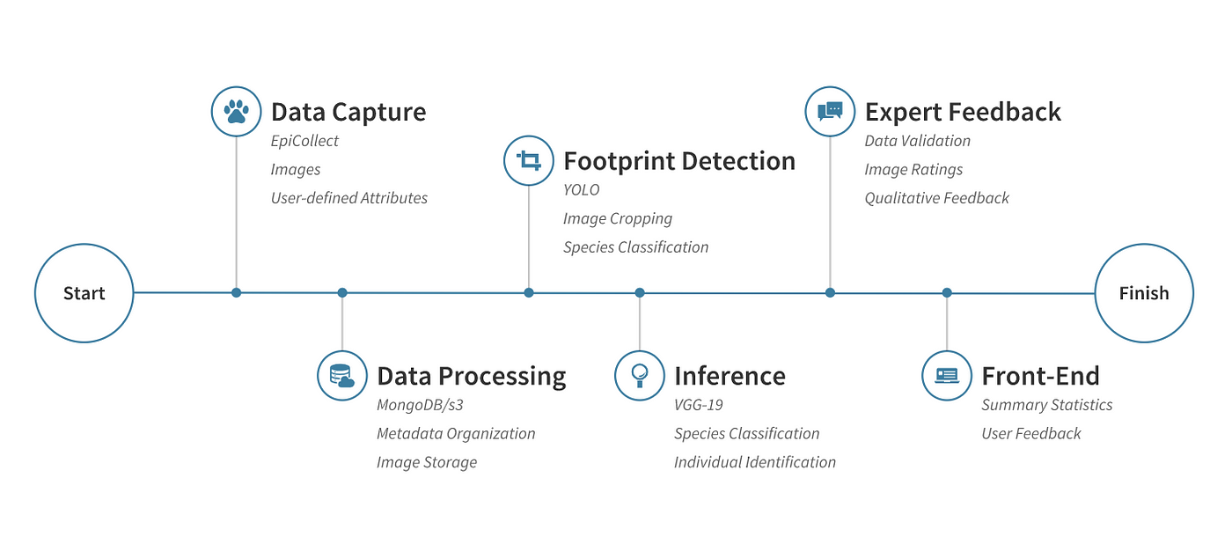
Proposed Method
❏ The proposed method is "Wild Animal Detection using Footprints."
This methodology consists of:-
Data Pre Processing
Canny Edge Method
PNN algorithm
Alert Generation
Canny Edge Method:-
The Canny edge detector is an edge detection operator that uses a multi-stage algorithm to detect a wide range of edges in images.

Slide 6
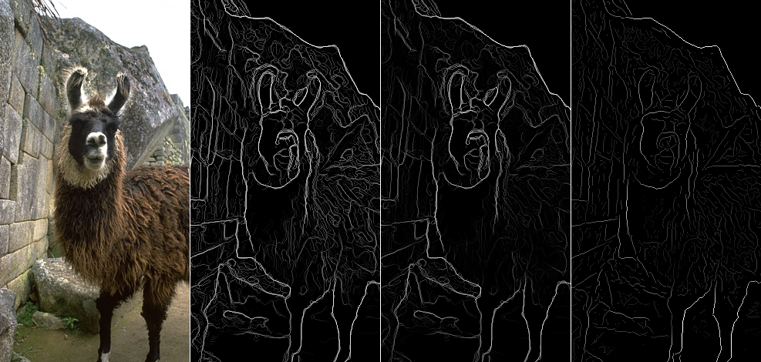
Proposed Method
The Canny edge detection algorithm is composed of 5 steps:
Noise reduction - One way to get rid of the noise on the image, is by applying Gaussian blur to smooth it.
Gradient Calculation - Gradient intensity and Edge direction
Non Maximum Suppression - Performed to convert thick edges into thin edges
Double threshold - The double threshold step aims at identifying 2 kinds of pixels: strong and weak
Edge Tracking - Based on the threshold results, the hysteresis consists of transforming weak pixels into strong one

Slide 7
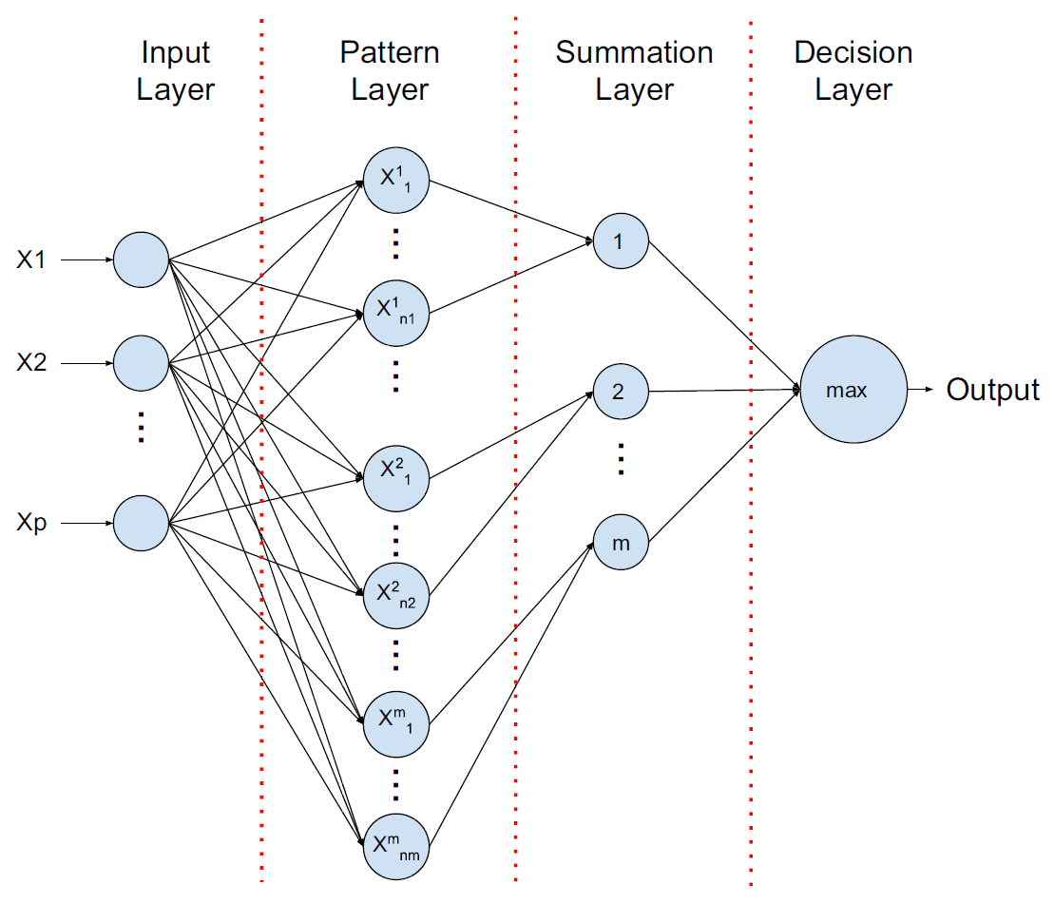
Proposed Method
PNN Algorithm :-
It is a machine learning algorithm used for various pattern recognition tasks, including animal detection using footprints. PNN is particularly well suited for classification tasks and is based on the principles of Neural networks and Bayesian statistics.
The PNN architecture has four layers:-
Input Layer - p neurons represents the input vector and distribute it to next layer.
Pattern Layer - During inference, each neuron calculates the Euclidian distance between input test vector and the training sample.
Summation Layer - This layer computes the average of the output of the pattern units for each class.
Output Layer - This layer selects the maximum value from the summation layer.

Slide 8
Project status
S No | Functionality | Status (Completed /in-progress/Not started)
1 | Data collection and pre processing | Completed
2 | Edge detection using canny algorithm | Completed
3 | Creating the deep learning model | In progress
4 | Training the model | In progress
5 | Classification and alert generation | Not yet started

Slide 9
References
IEEE Paper – Multiple Object Tracking Using Edge Multi-Channel Gradient Model With ORB Feature
(URL - https://ieeexplore.ieee.org/stamp/stamp.jsp?tp=&arnumber=9305221)
Canny edge detection
(URL - https://indiantechwarrior.com/canny-edge-detection-for-image-processing/ )
ANIMAL DETECTION USING DEEP LEARNING ALGORITHM
(URL -
https://www.jcreview.com/admin/Uploads/Files/61a583d589b358.69371631.pdf )

